Slide 1
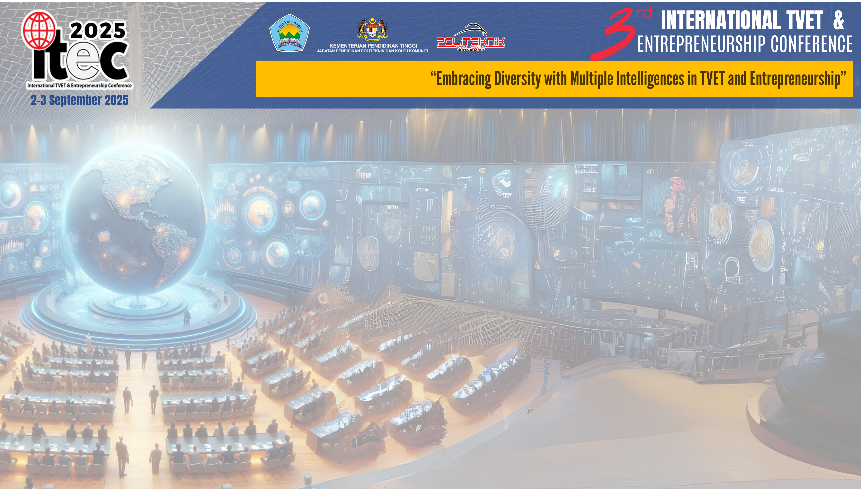

TITLE:
INSERT YOUR PHOTO
HERE
BUILDING INFORMATION MODELING (BIM):
BENEFITS, RISKS AND CHALLENGES
[E04]
Maslinda binti Sabri
Department of Civil Engineering,
Politeknik Kota Bharu, Malaysia

Slide 2
